Slide 1
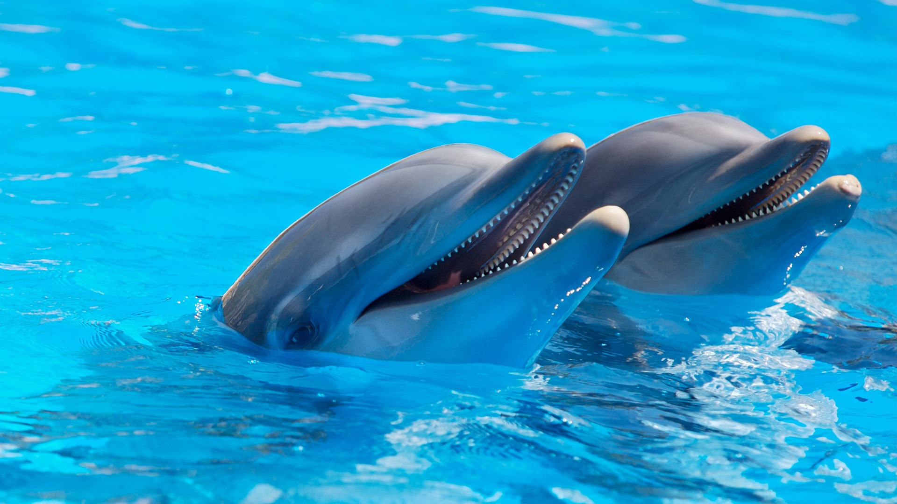
This is the logo now
Wildlife Society
f
G
T
I
Home
About
Contact
Parks
More
Welcome
To the world wild life society
>

Slide 2
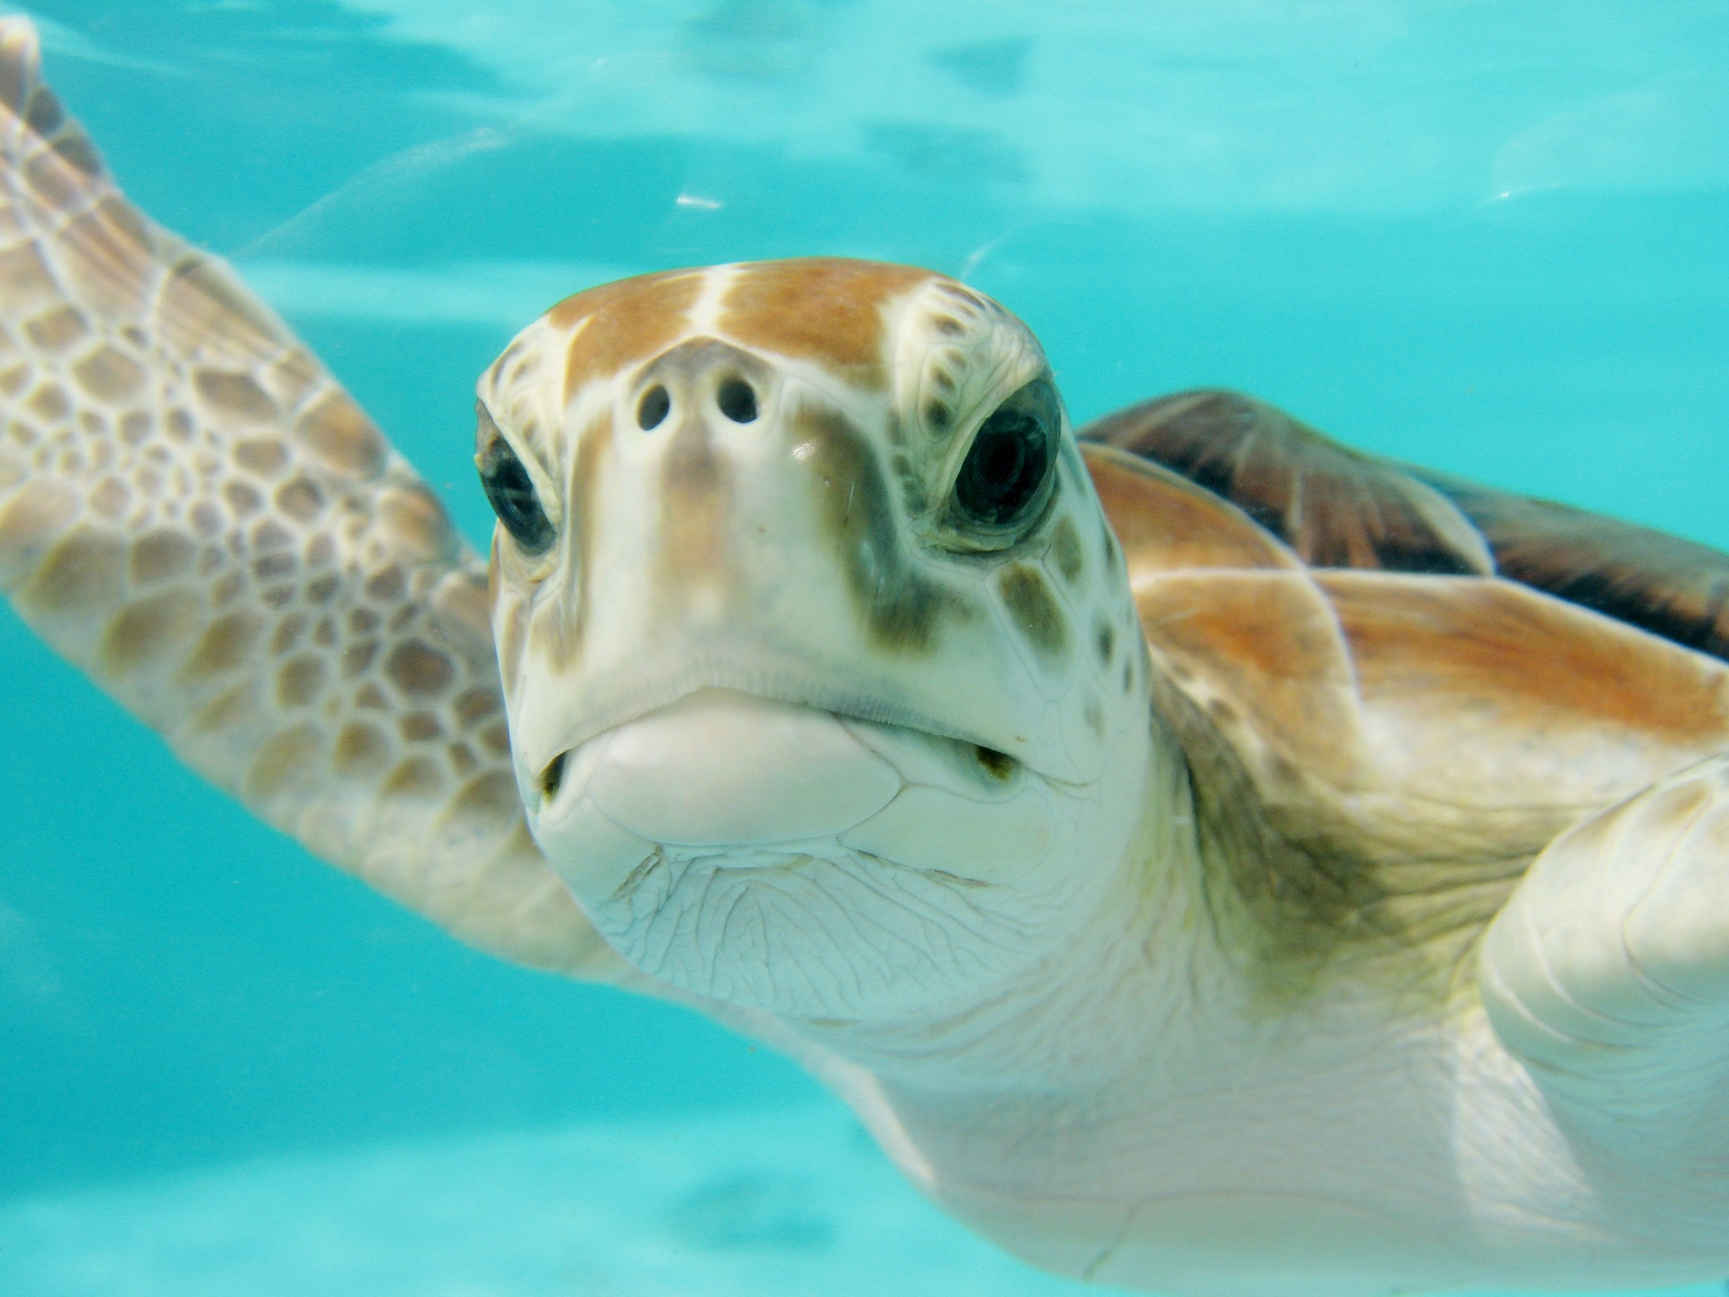
About
We stand to protect the wild life
society
We all love all species to live long for our future generations to see
More

Slide 3
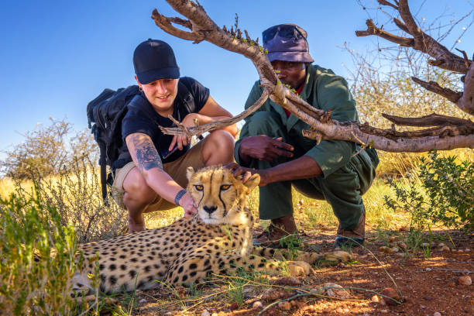
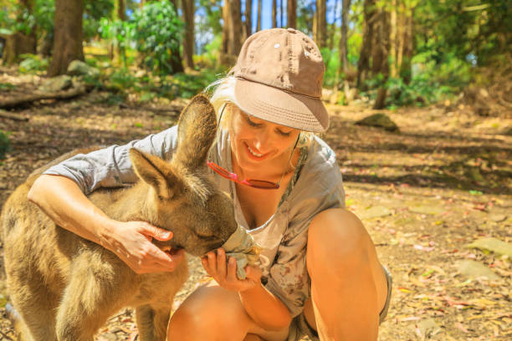
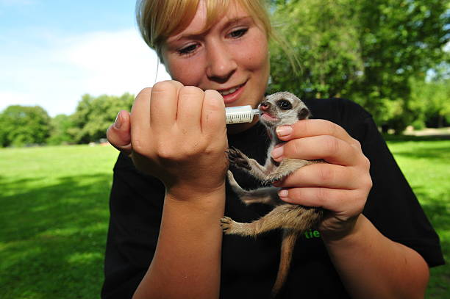
Conservation of wild life
Together lets Conserve the wild life.
It is so important that we all together come to the love of the wild life animals so let us come together and aim at conserving our wild species of deferent kinds
Feed Predators
Feed Marsupials
Feed the Tiny

Slide 4
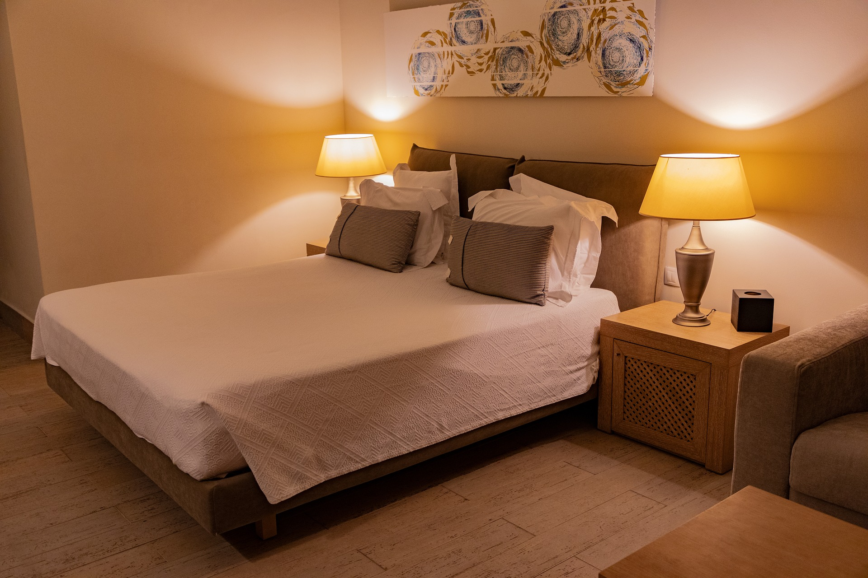
Take a tour to the wild
We'll take good care of you on your amazing tour to our wild life
Safety first
Come for the tour and leave everything to us
Do not worry about anything, we’ve got your back. We have everything to take good care of you, we have assured good accommodation, good transporting systems, good and kind attendants to guide you on your tour
Good luxurious areas to relax your self in, nice and fast medical insurance system to take care of your health status
More

Slide 5
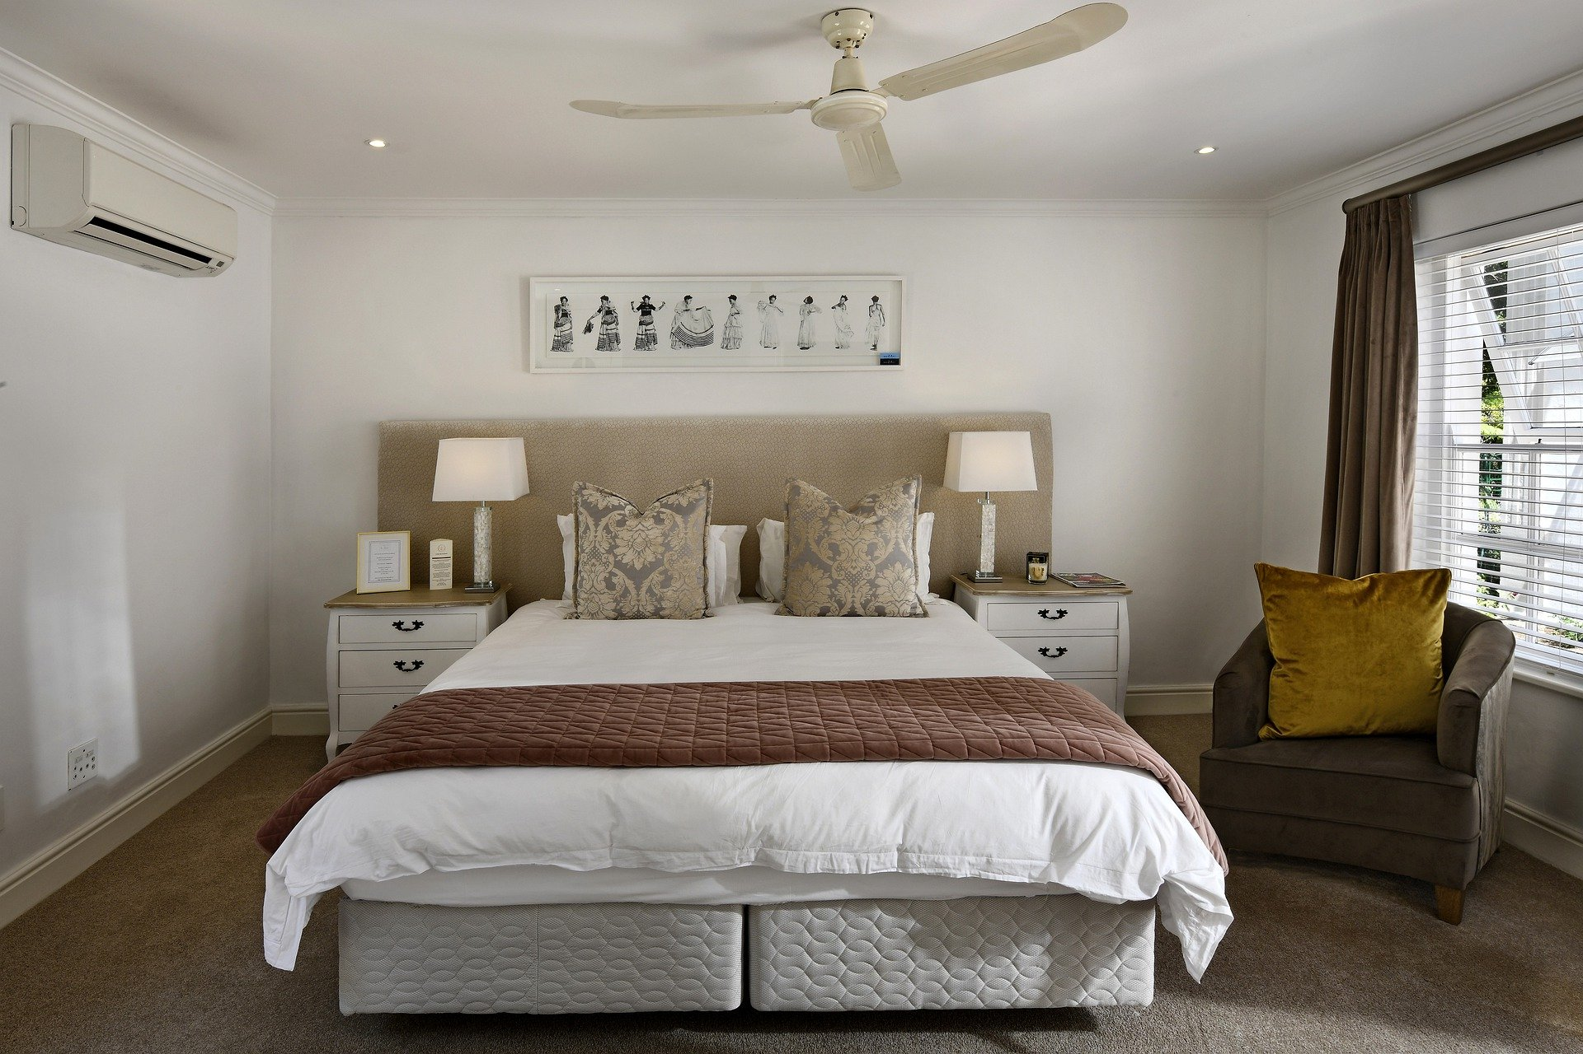
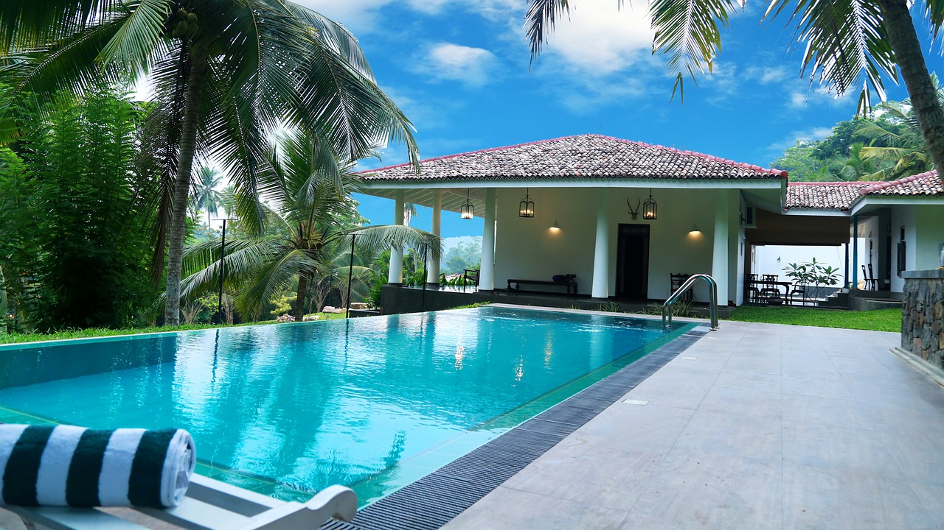
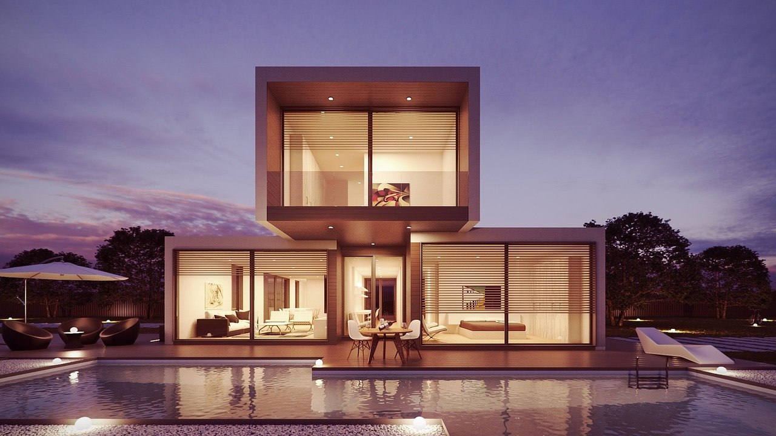
Sleep well
Relaxing
Housing
We have nice convenient bedrooms that can not ever make your sleep uncomfortable
Relax and have fun relaxing
In a well conserved place like this from any ware any
Time you wish
We have nice self contained
Houses that can contain you
And you family
As well
More
More
More

Slide 6
WE ARE PROUDLY WAITING FOR YOU
You can easily get to us by clicking the button bellow
GET A QUOTE

Slide 7
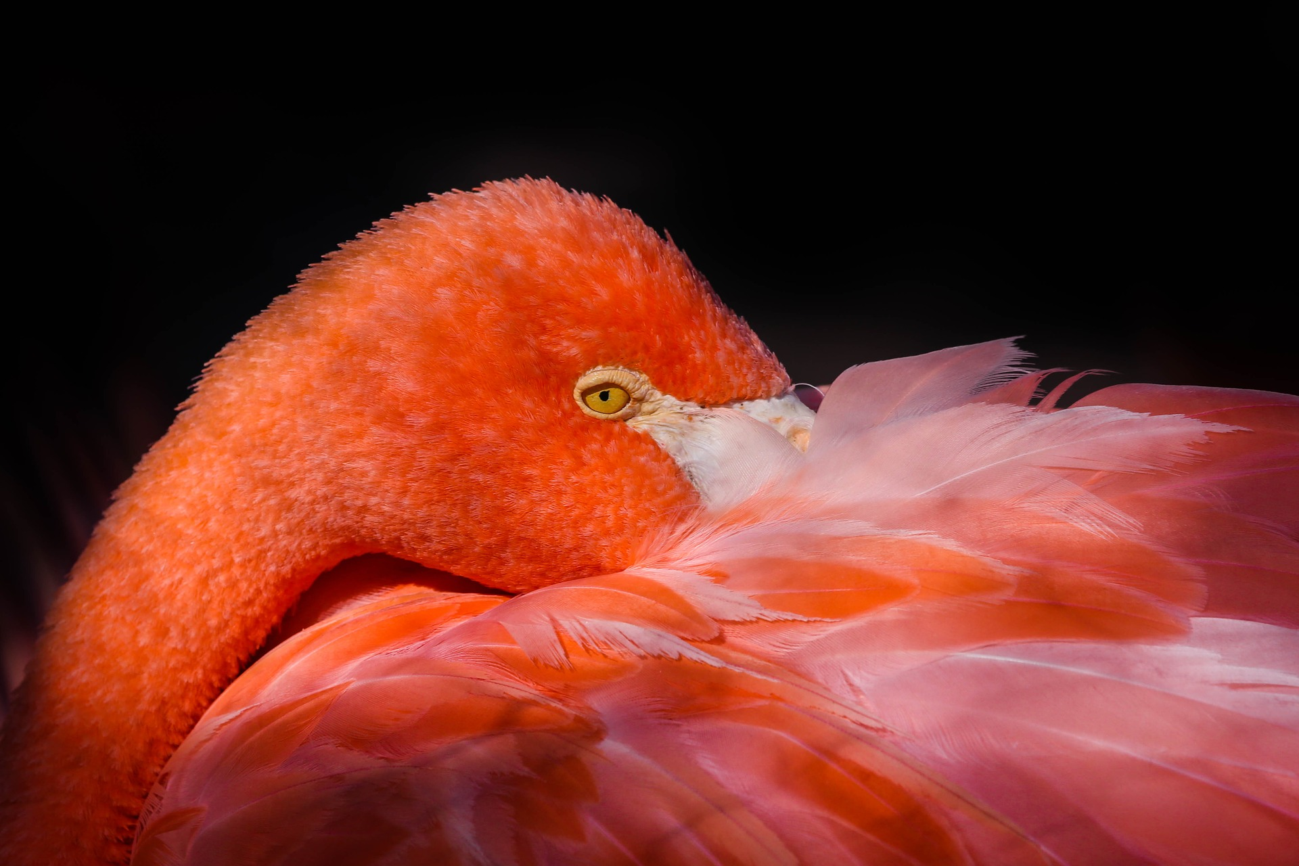
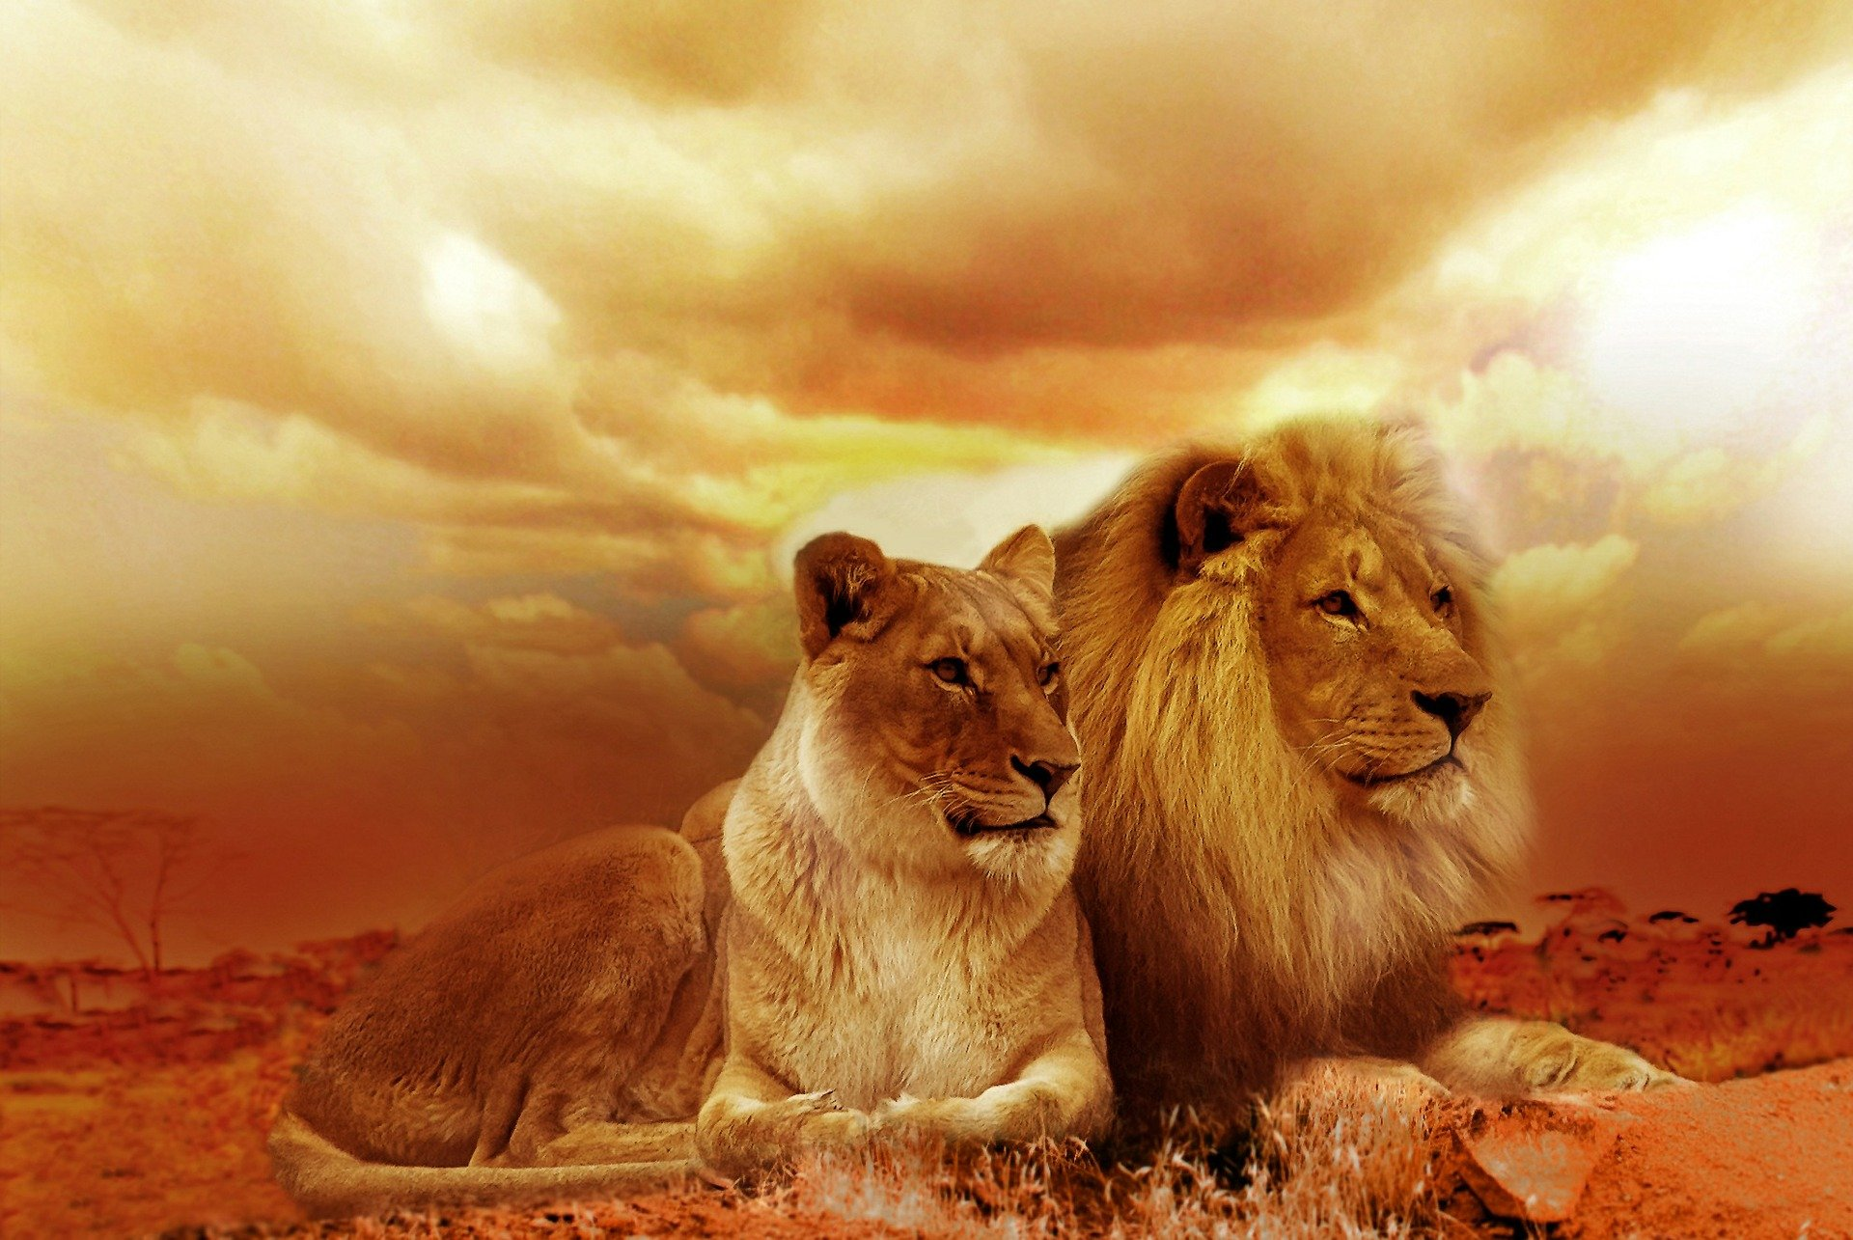
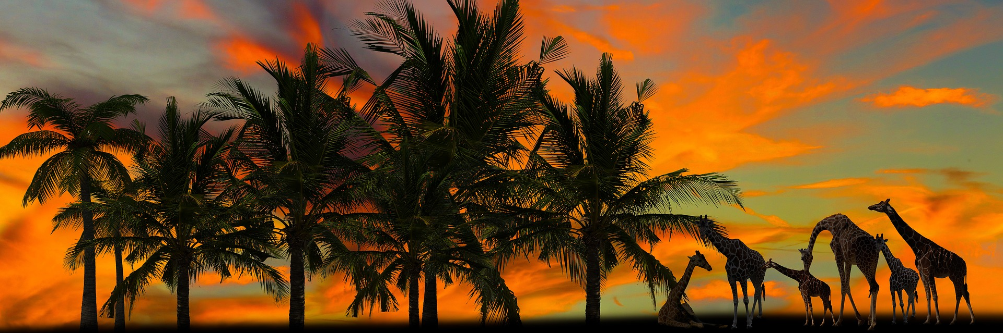
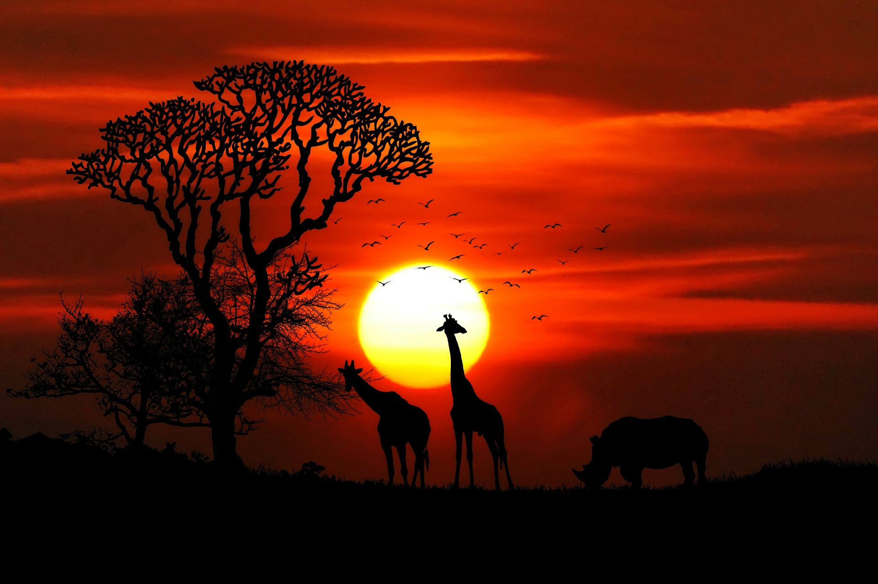
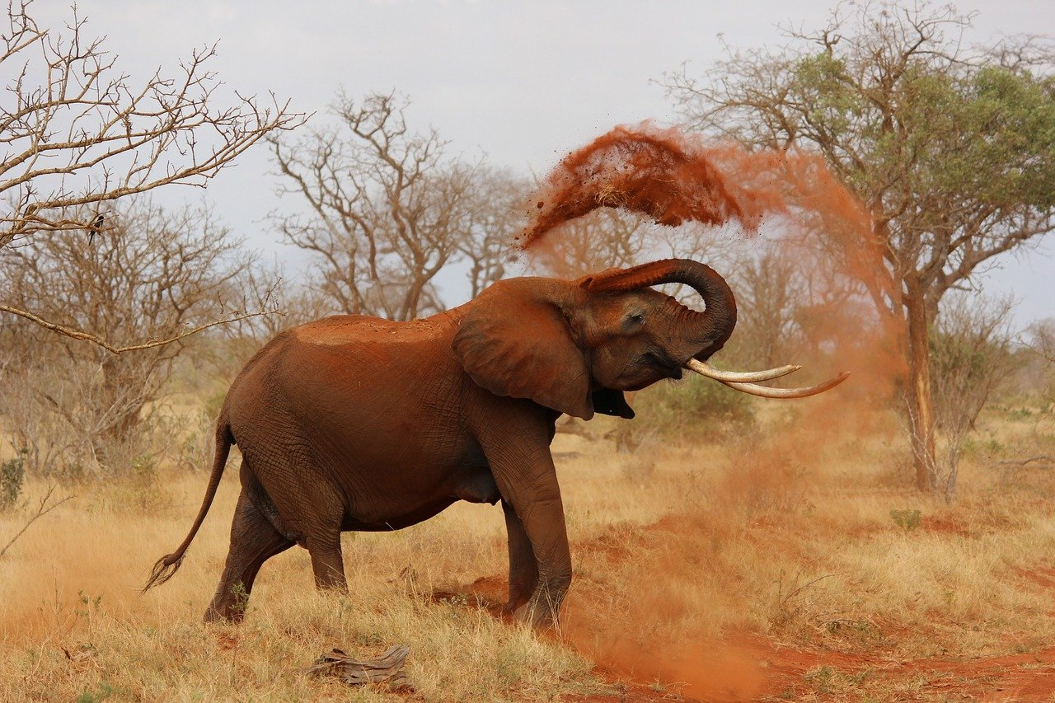
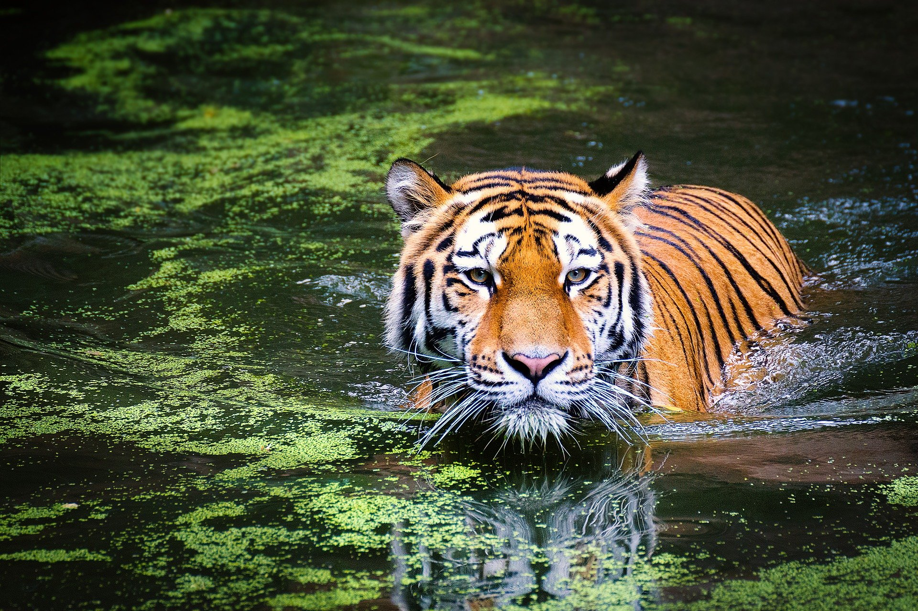
Birds
More
Animals
More
Plants
More
More
More
More
Africa
Asia
America

Slide 8
Contact us
Feel free and
Leave us
A message
Email
Message…
Communicate to us and let us know your concern about us and the wildlife conservation.
Thank you
More
Send

Slide 9
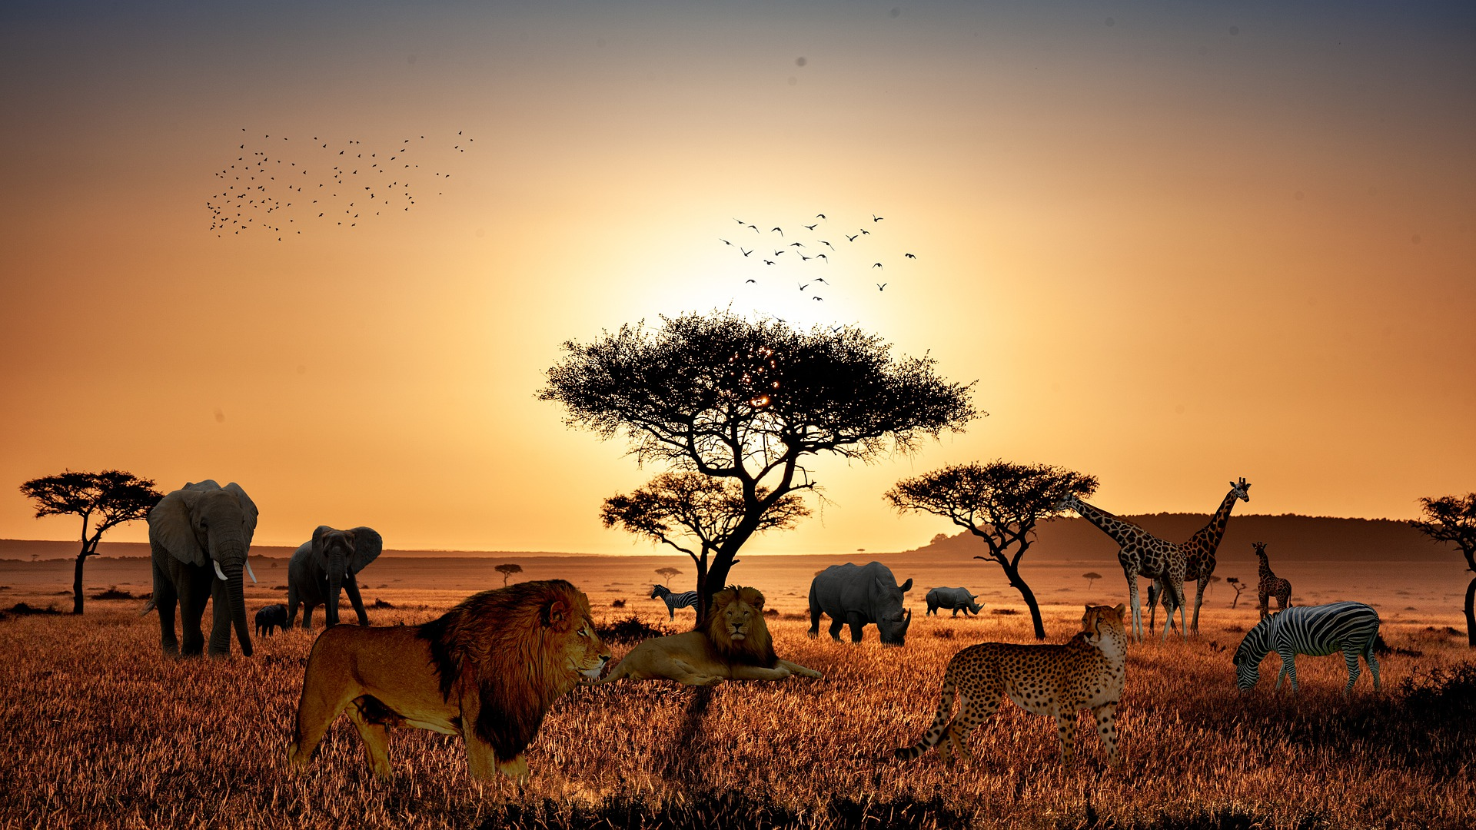
W L S
W L S
© Wildlife Society 2020 - 2025

Slide 10
